Slide 1
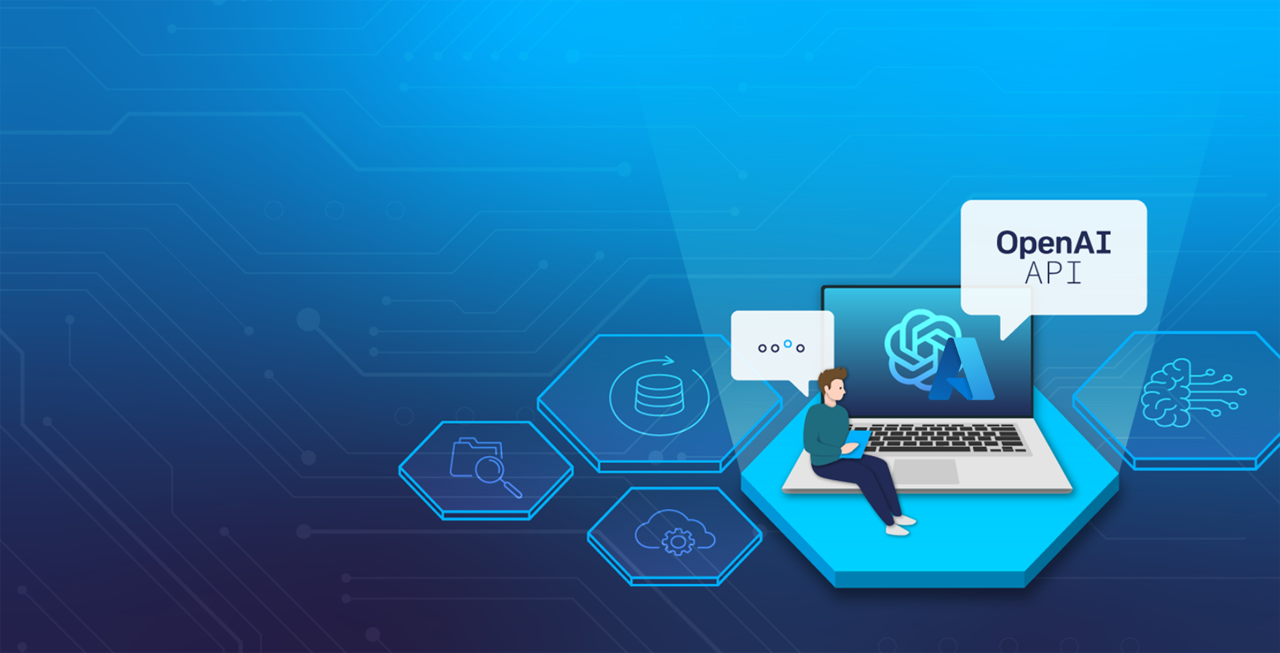
Introduction
A Hands-on Exploration of the Azure OpenAI API
27.05.2025

Slide 2

13:00 – 14:00
Introduction (Part 1)
Workshop Preparations (Part 2)
Using the Azure OpenAI API (Part 3)
15:00 – 15:30
Coffee Break
15:30 – 16:45
Retrieval-Augmented Generation (Part 4)
Fine-Tuning (Part 5)
Image-To-Text using GPT-4o (Part 6)
16:45 – 17:00
Extras | Q&A

Slide 3
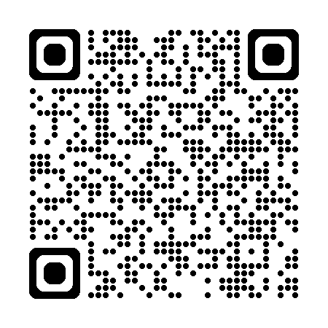
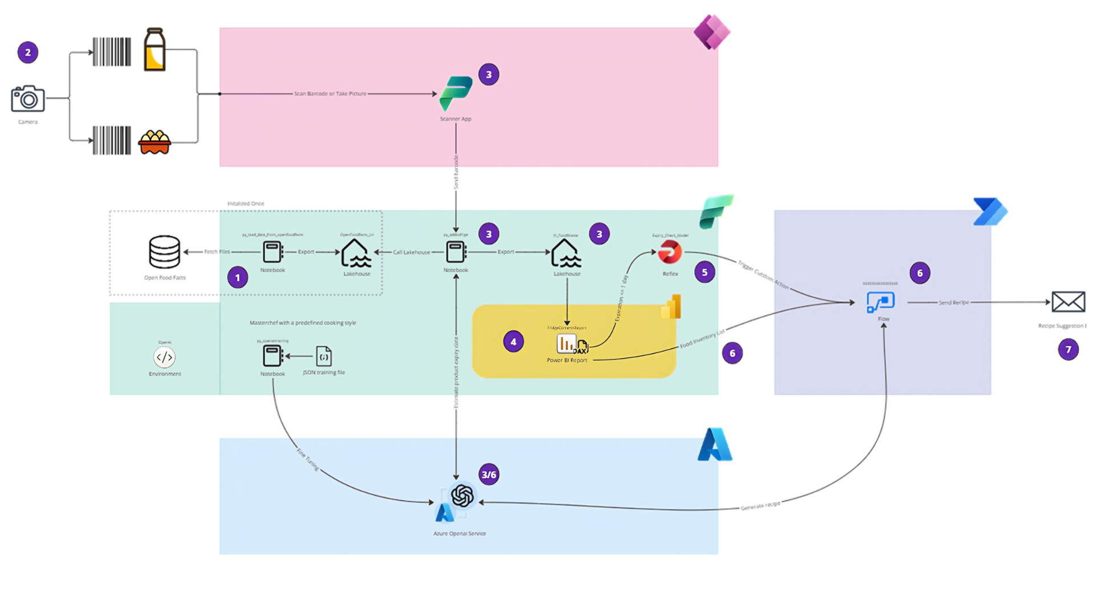
Workshop Use Case
Food Fighters
Notes:
The use case of this workshop series revolves around the Food Fighters concept created for The Microsoft Fabric Global AI Hack of 2024.
The solution aims to combat food waste by empowering users to effortlessly manage their food inventory, track food expiration dates, and receive personalized recipe suggestions via email, all with a simple product scan.
Unfortunately, we don't have time to build the entire architecture of this solution, for this reason, we will focus on creating the personalized recipe suggestions aspect using Azure OpenAI Service.
AllgeierSchweiz/aihackers: Github Repo for the Fabric AI Hackathon. Feel free to fork and have fun with it.

Slide 4

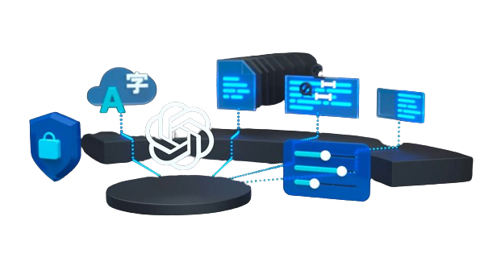
Empowering You
Azure OpenAI Service
Access to various large language models (LLMs), including GPT-4.1 (mini, nano), GPT-4o (mini), and Embeddings model series.
These are the same language models made available by OpenAI.
Additionally, new model catalog in Azure AI Foundry with 11K+ models to choose from.
Azure OpenAI Service powers the next generation of startups | Microsoft for Startups Blog
Notes:
The Azure OpenAI Service offers access to various large language models (LLMs), including GPT-4o, GPT-4, GPT-4 Turbo with Vision, GPT-3.5-Turbo, and Embeddings model series. These are the same language models made available by OpenAI.

Slide 5







Empowering You
Objectives
1
4
Create recipes from a list of ingredients.
Improve created recipes using Fine-Tuning.
2
5
Improve created recipes using enhancement techniques: prompt engineering with zero-shot, one-shot, and few-shot learning.
Showcase data pre-processing Azure OpenAI Assistant API.
3
6
Improve created recipes using Retrieval Augmented Generation (RAG).
GPT-4o
Showcase GPT-4o-mini model, translating images into text.
Notes:
We want the language model to create recipes from a list of ingredients we pass as the model input.
To improve the recipes created by the model we will implement model enhancement techniques such as prompt engineering with zero-shot, one-shot and few-shot learning.
To further improve the recipes created by the model, specifically creating vegan recipes in JSON format, we will implement an retrieval strategy called Retrieval Augmented Generation (RAG) using a CSV file of vegan recipes as our data foundation.
To further improve the recipes created by the model we will implement an enhancement technique called Fine-Tuning to re-train the base language model using a CSV file of vegan recipes as our training data. Furthermore, we will explore the implementation of RAG together with a fine-tuned model.
Before implementing the enhancement techniques listed in steps 3 and 4, we need to perform data preparation steps on the CSV file. To achieve this, we will use the Azure OpenAI Assistant API with the code interpreter functionality. This will allow us to conduct data-wrangling steps on the data based on our natural language inputs.
We want to create a list of ingredients from a set of food product images that can be used to generate recipes. To achieve this, we will utilize the multimodal GPT-4o model, which enables the translation of images into text.

Slide 6

Empowering You
Large Language Models Used
GPT-4o-mini
Text-Embedding-3-Large
Notes:
In our case, we will use the language models GPT-4o, GPT-4, GPT-3.5-Turbo, and Embeddings. Each one will be called using the Azure OpenAI API. Additionally, we will use the Azure OpenAI Assistants API to perform data pre-processing operations using the code interpreter functionality.

Slide 7
Empowering You
Enhancement Techniques
Limited to contex window
Connect external data sources
Easy to work with
Fast prototyping
Dynamic knowledge in the prompt
Prompt Engineering
Intuitive
Real-time
RAG
Better output
Steer behavior
Apply data & domain knowledge
Fine-tuning
Narrows model’s behavior More predictable outputs Bakes in style/tone/format
Approaches to AI: When to Use Prompt Engineering, Embeddings, or Fine-tuning | Entry Point AI

Slide 8
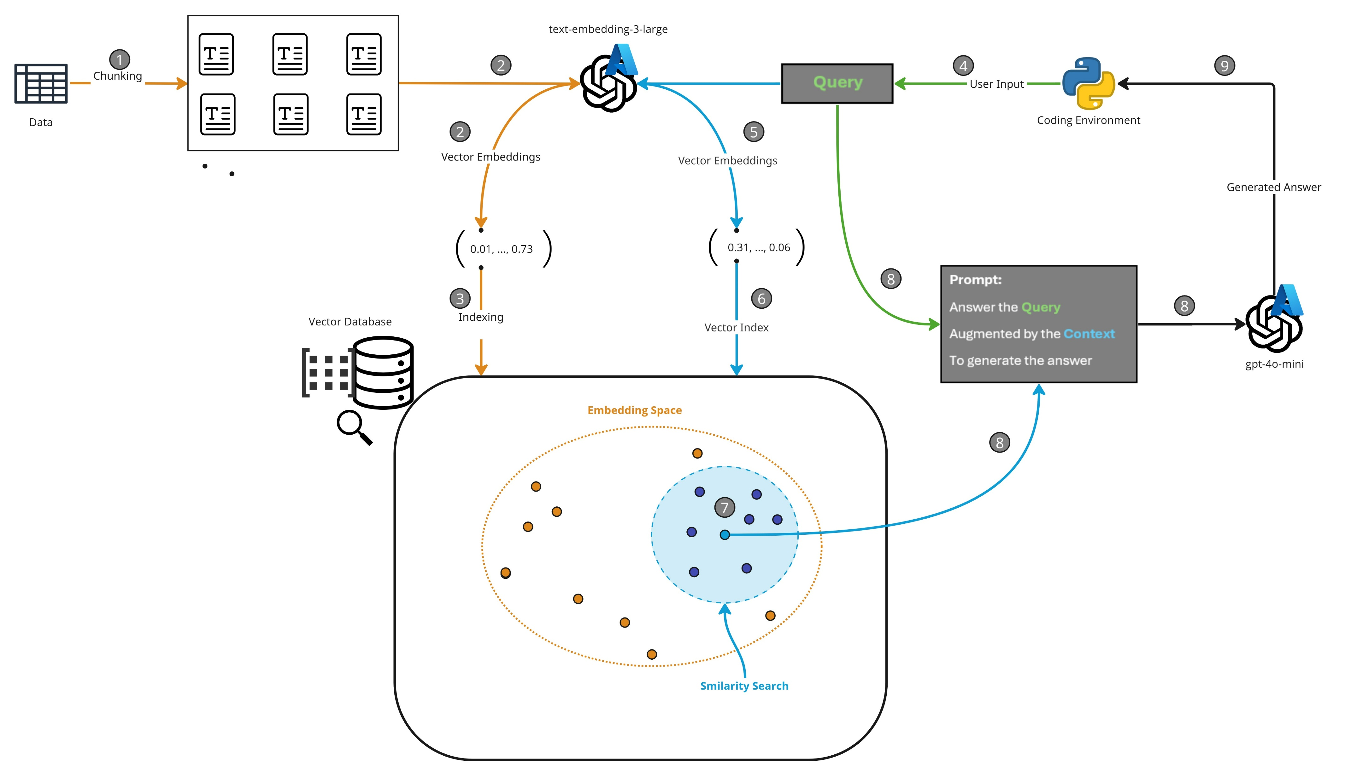
Retrieval Augmented Generation
Notes:
Retrieval Augmented Generation (RAG) is a retrieval strategy aimed at enhancing language models by providing them with supplementary information, a process also known as grounding. Rather than solely depending on the model’s existing knowledge, we can add proprietary data into the model prompt to guide it to more precise and domain-specific responses. It’s important to note that the model is not re-trained on the new data. The new data is only used as an additional prompt input, acting similarly to one-shot learning.

Slide 9
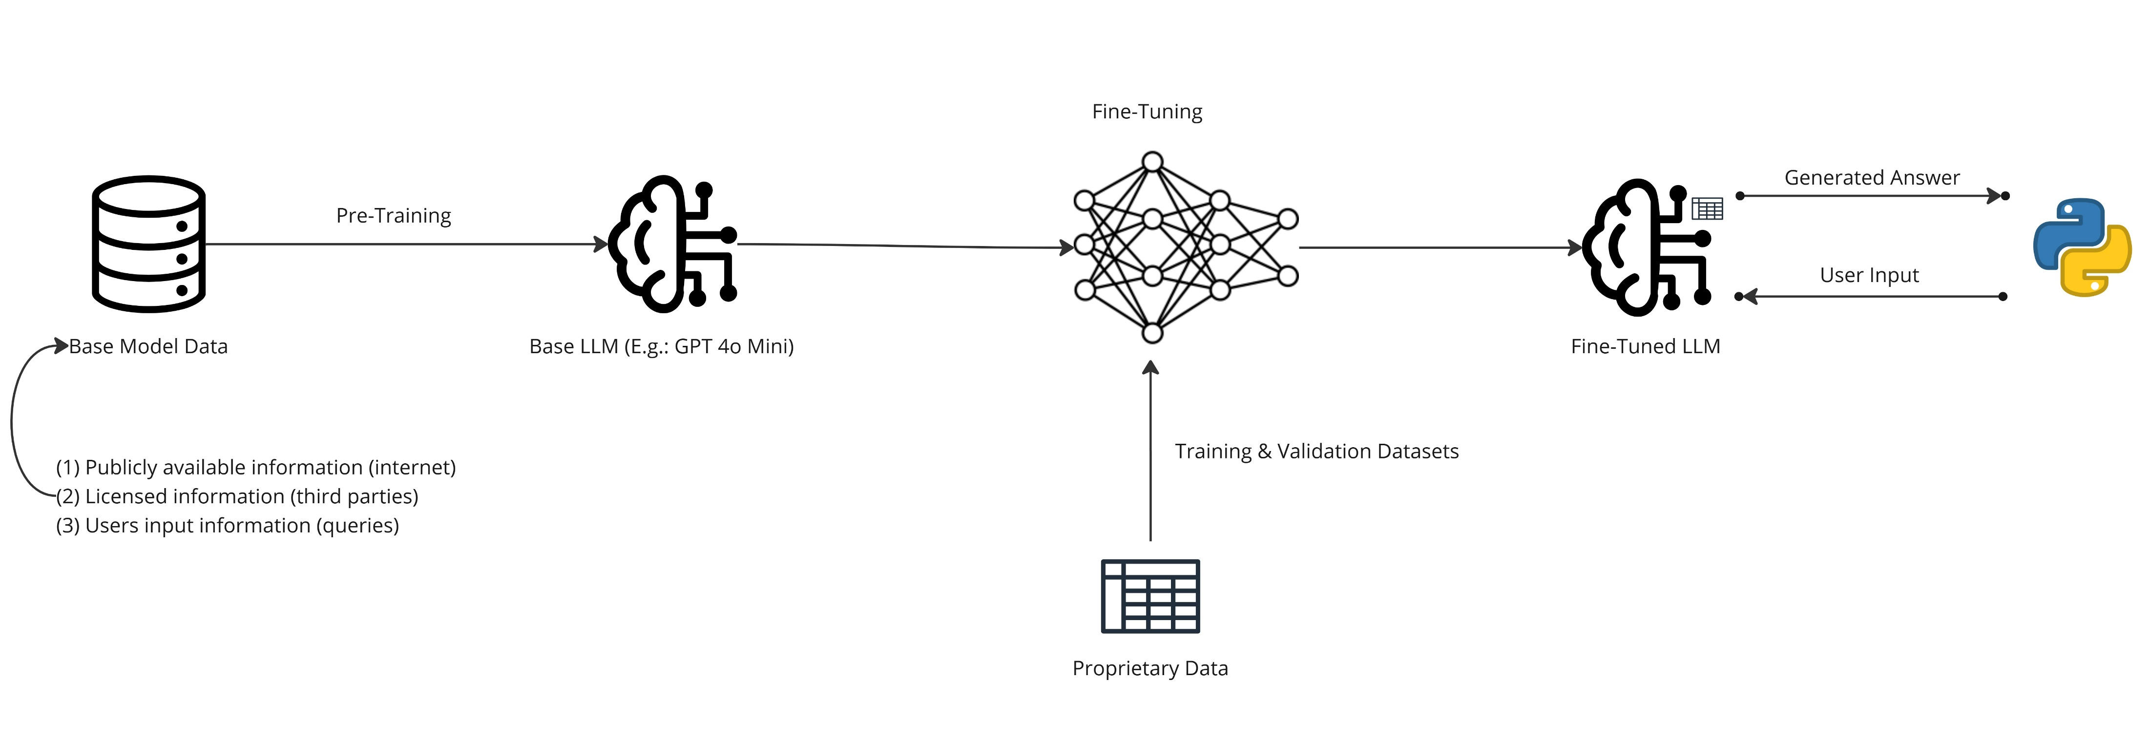
Fine-Tuning
Notes:
Fine-tuning is a technique used to re-train a pre-trained model using a new foundation of information i.e. training data, to suit a specific task.

Slide 10

Empowering You
Scan the QR code and open the git repository on your PC
https://tinyurl.com/aoiworkshop
QR Code Generator (the-qrcode-generator.com)

Slide 11
Questions?

